Slide 1

ELEC-8900-57 Special Topic - Machine Learning Reinforcement Learning: Policy Gradient methods
Presented by:
Saad Ahmed Salim
Ashab Uddin
Instructor: Dr. Yasser Alginahi
Date: 17 November 2023

Slide 2
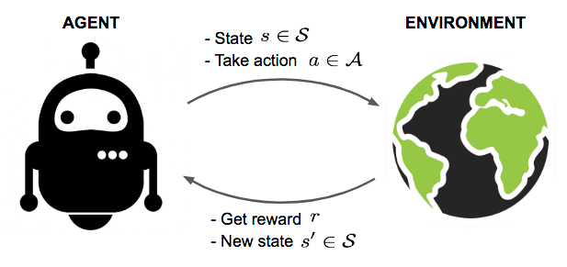
What is Reinforcement Learning (RL)?
An agent interacts with the environment, trying to take smart actions according to current state to maximize cumulative rewards.
https://lilianweng.github.io/posts/2018-02-19-rl-overview/?fbclid=

Slide 3
Key Concepts
To determine the optimal policy to maximize long term reward
How it works
Don’t know anything about the path.
Goal is to find safe path.
No info before, learn from actions.
Reward & Penalty.

Slide 4
Comparison among Supervised, Unsupervised Learning and RL
Supervised | Unsupervised | Reinforcement
Labeled Data | Unlabeled data | An environment
Take actions using data | No clue about data. Take steps to determine the answer | No information before, learn from action
Photo identification, CT scan to detect tumor | Online shop product recommendation, Credit card fraud detection | Self Driving car, Gaming Bot

Slide 5
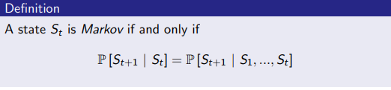
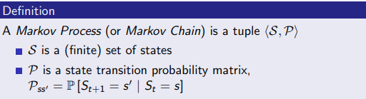
Markov Property and Markov Process
Markov Process : A stochastic process has Markov property if conditional probability distribution of future states of process depends only upon present state and not on the sequence of events that preceded. Markov Decision Process: A Markov decision process (MDP) is a discrete time stochastic control process [2].

Slide 6
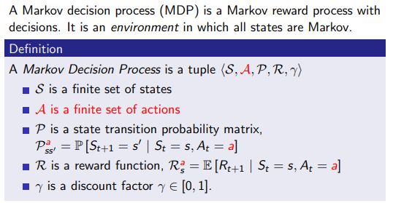
MDP
https://www.davidsilver.uk/wp-content/uploads/2020/03/MDP.pdf
Notes:
we need gama to discount the value of future rewards in the agents decision making process.

Slide 7
Policy
Deterministic policy
The deterministic policy output an action with probability one. For instance, In a car driving scenario, consider we have three actions: turn left, go straight, and turn right. The RL agent with deterministic policy always outputs one of the actions with probability 1.
policy determines how the agent behaves from a specific state.
There are two types of policies: deterministic policy and stochastic policy.
Stochastic policy
Stochastic policy output the probability distribution over the actions from states. For instance, consider an action steering angle of vehicle: The output of the policy will be a probability distribution with mean and standard deviation say (5,10).

Slide 8
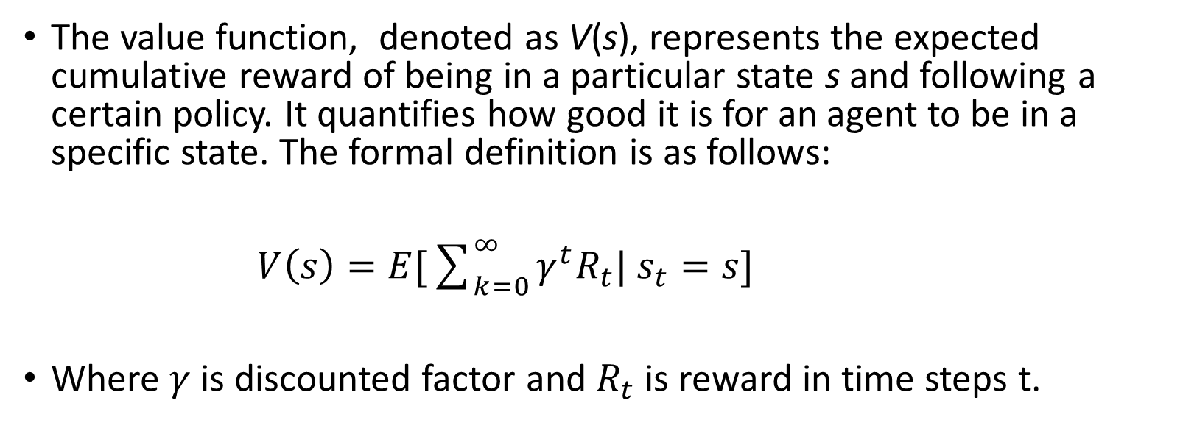
Value Function
The value function, denoted as V(s), represents the expected cumulative reward of being in a particular state s and following a certain policy. It quantifies how good it is for an agent to be in a specific state. The formal definition is as follows:
$V\left(s\right)=E[\sum_{k=0}^{∞}{γ^{t}R_{t}| s_{t}=s}]$
Where $γ$ is discounted factor and $R_{t}$ is reward in time steps t.
Notes:
q function and value function - used to estimate the expected cumulative reward of an agents actions.

Slide 9
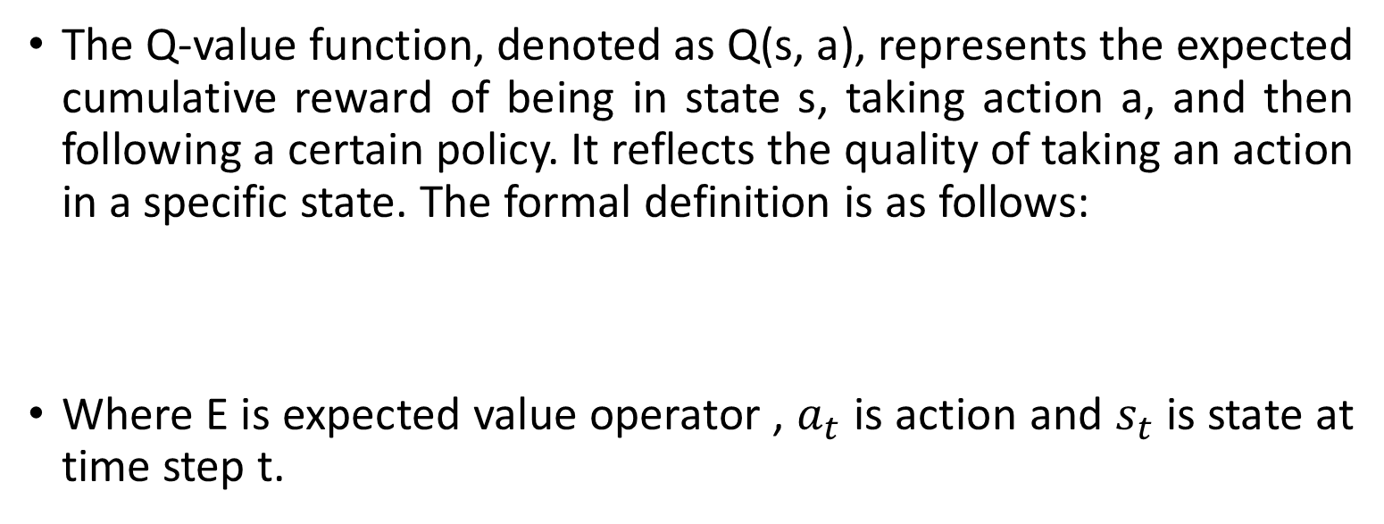
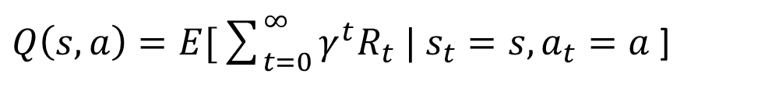
Q-Value Function
The Q-value function, denoted as Q(s, a), represents the expected cumulative reward of being in state s, taking action a, and then following a certain policy. It reflects the quality of taking an action in a specific state. The formal definition is as follows:
Where E is expected value operator , $a_{t}$ is action and $s_{t}$ is state at time step t.
$Q\left(s,a\right)=E[\sum_{t=0}^{∞}{γ^{t}R_{t} | s_{t}=s, a_{t}=a }$]
Notes:
state-action pair (s,a) under a policy is denoted as Q(s,a) and represents the expected cumulative future reward starting from state s, taking action a, and following policy.

Slide 10
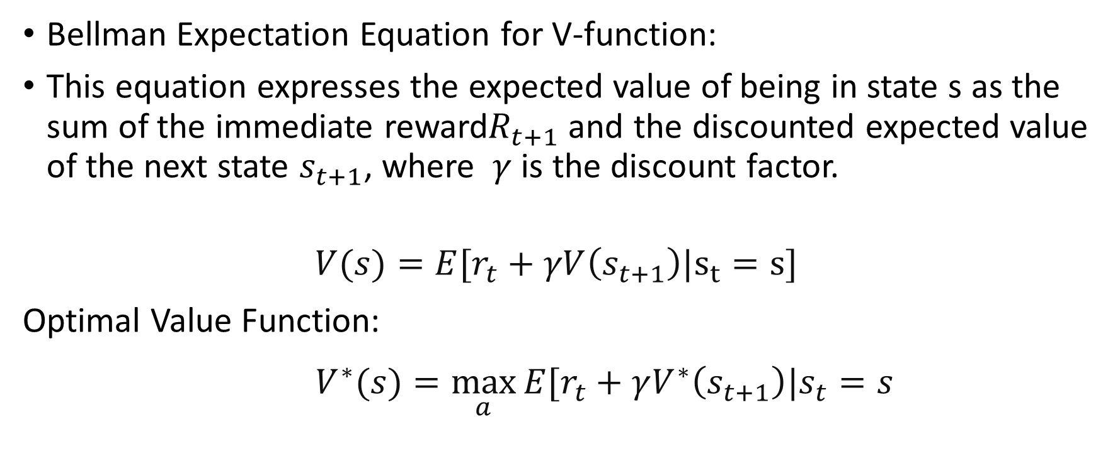
Bellman Equation for Value Function
Bellman Expectation Equation for V-function:
This equation expresses the expected value of being in state s as the sum of the immediate reward$R_{t+1}$and the discounted expected value of the next state $s_{t+1}$, where $γ$ is the discount factor.
$$V(s)=E[r_{t}+γV\left(s_{t+1}\right)|s_{t}=s]$$
Optimal Value Function:
$V^{∗}(s)=\max_{a}{E[r_{t}+γV^{∗}\left(s_{t+1}\right)|s_{t}=s }$
Notes:
Here, Rt+1 is the immediate reward at time t+1,γ is the discount factor, and the expectation
is taken over the possible future trajectories according to the policy.

Slide 11
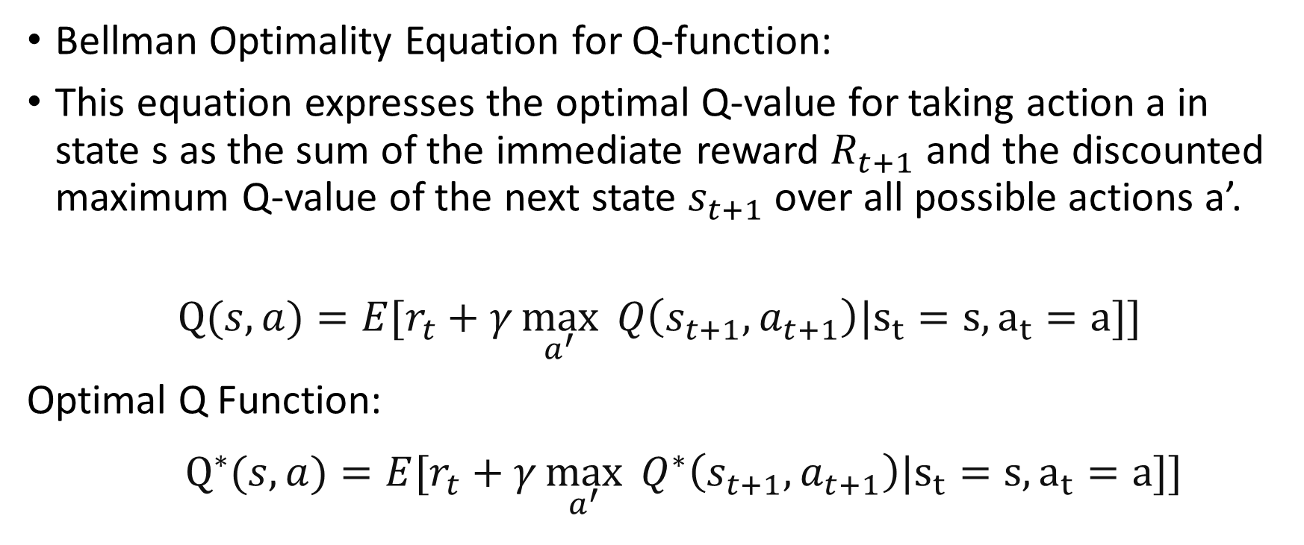
Bellman Equation for Q function
Bellman Optimality Equation for Q-function:
This equation expresses the optimal Q-value for taking action a in state s as the sum of the immediate reward $R_{t+1}$ and the discounted maximum Q-value of the next state $s_{t+1}$over all possible actions a’.
$$Q(s,a)=E[r_{t}+γ\max_{a^{′}}{ Q\left(s_{t+1},a_{t+1}\right)|s_{t}=s,a_{t}=a]]}$$
Optimal Q Function:
$Q^{∗}(s,a)=E[r_{t}+γ\max_{a^{′}}{ Q^{∗}\left(s_{t+1},a_{t+1}\right)|s_{t}=s,a_{t}=a]]}$

Slide 12
Limitation of Value Based Method
Difficulty in Handling Continuous Action Spaces
Overestimation Bias
Exploration Challenges
Lack of Convergence Guarantees
Suboptimal Policies for Stochastic Environments

Slide 13
Advantage of Policy Gradient method
Better convergence properties
Effective in high-dimensional or continuous action spaces
Learning stochastic policies
Exploration Increase

Slide 14
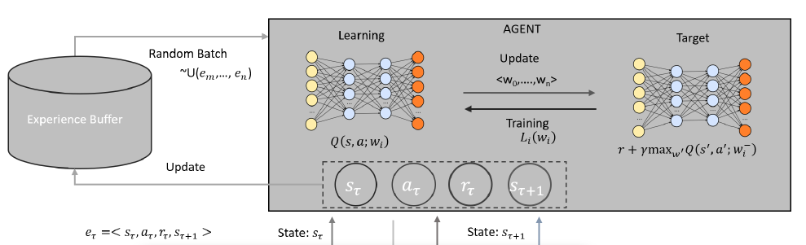
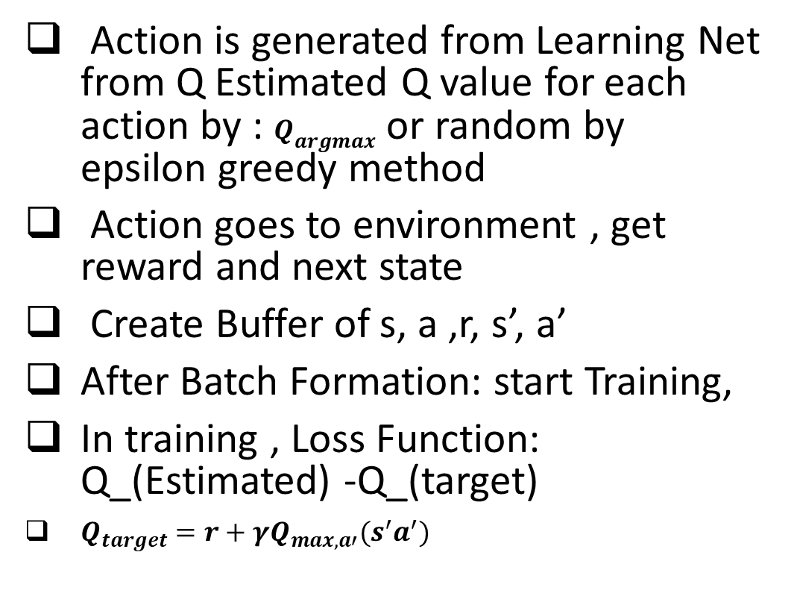
What we did in DQN [9]
Action is generated from Learning Net from Q Estimated Q value for each action by : $Q_{argmax}$ or random by epsilon greedy method
Action goes to environment , get reward and next state
Create Buffer of s, a ,r, s’, a’
After Batch Formation: start Training,
In training , Loss Function: Q_(Estimated) -Q_(target)
$Q_{target}=r+γQ_{max,a′}(s^{′}a^{′})$
Environment: s, a, r, s’

Slide 15

Policy Gradient Method
Estimate the probability of action for a given state that will give a long-term reward for the whole trajectory. When an agent follows that actions in each time step that is called policy , that can be defined as $π_{θ}\left(s,a\right)$dependent on parameters $θ$ called policy parameters. $π_{θ}\left(s,a\right)$ is called stochastic policy because it indicates the probability of taking an action a being in state s.

Slide 16

Policy Gradient Mathematics
$J\left(θ\right)=V^{π}\left(s\right)$ $=\sum_{a}{Q^{π}\left(s,a\right)∗π(a|s)}$
Here π is probability distribution of action parameterized by $θ$ [6]

Slide 17
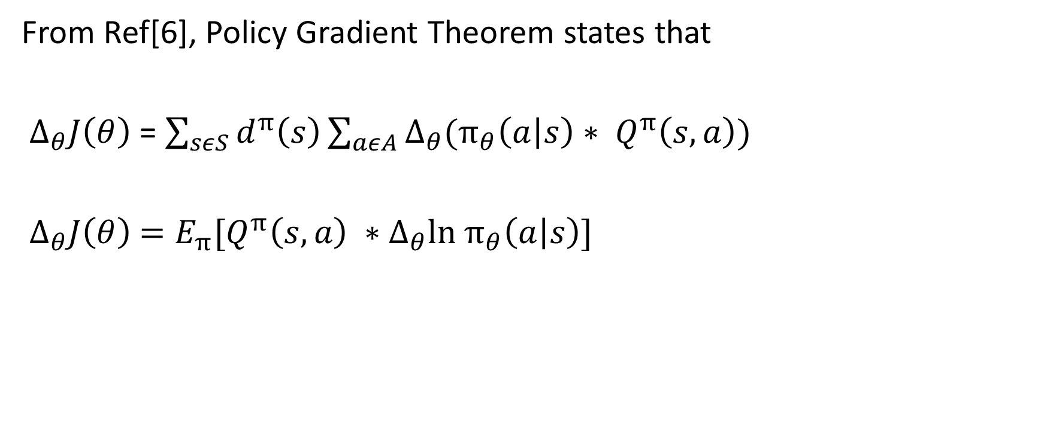
Policy Gradient Mathematics
From Ref[6], Policy Gradient Theorem states that
${ Δ}_{θ}J\left(θ\right)$ = $\sum_{sεS}{d^{π}\left(s\right)\sum_{aεA}{Δ_{θ}{(π_{θ}\left(a | s\right)∗ Q}^{π}\left(s,a\right)})}$
$Δ_{θ}J\left(θ\right)$ $=E_{π}[Q^{π}\left(s,a\right) ∗Δ_{θ}ln π_{θ}\left(a | s\right)]$

Slide 18
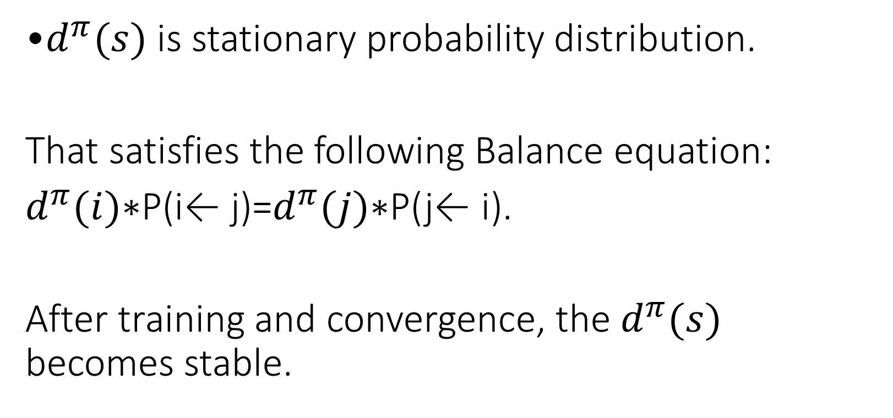
Policy Gradient Mathematics
•$d^{π}(s)$ is stationary probability distribution.
That satisfies the following Balance equation:
$d^{π}(i)$∗P(i← j)=$d^{π}(j)$∗P(j← i).
After training and convergence, the $d^{π}(s)$ becomes stable.

Slide 19
Policy Gradient: Soft Actor Critic Method
Entropy : how random a random variable is. If a coin is weighted so that it almost always comes up heads, it has low entropy; if it’s evenly weighted and has a half chance of either outcome, it has high entropy.
For example, in stochastic policy-based actor network : in state s1, a1(µ,σ) =(0,10) and in s2 , a2 (µ,σ) =(0,20). Which action will have more variance in sampling:
Action a2 will have more exploring capability to find action because the standard deviation is 20.

Slide 20

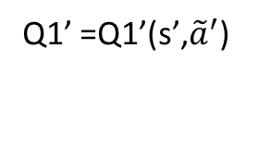
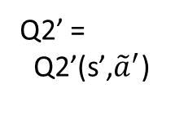

Soft Actor Critic Network Architecture
Critic 1
Φ1
Critic 1 Target
Φ1’
${\tilde{a}}^{′}$(Π(Θ)|s’)
Q1(s,a)
Q1’ =$\text{Q}\text{1’(}\text{s}\text{’,} {\tilde{a}}^{′}\text{)}$
Actor network
Π(Θ)
S | a | r | S’ | d
a(Π(Θ)|s)
Critic 2
Φ2
Critic 2 Target
Φ2’
r
Q2’ =
$$\text{Q}\text{2}\text{’(}\text{s}\text{’,} {\tilde{a}}^{′}\text{)}$$
s
Q2(s,a)
S’

Slide 21
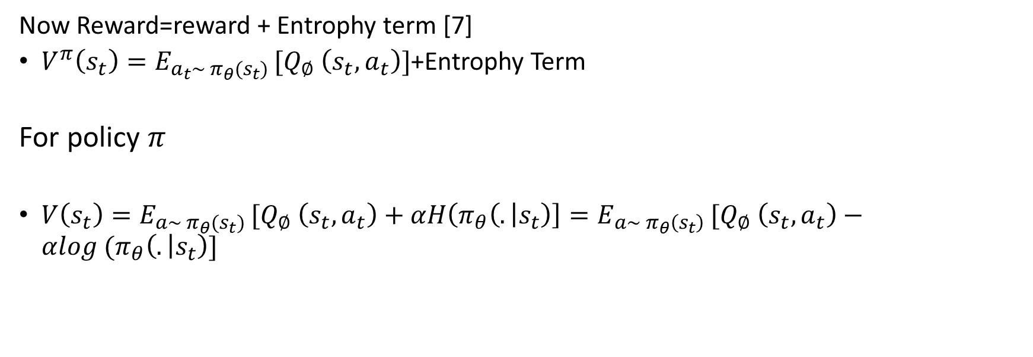
Soft Actor Critic Reward
Now Reward=reward + Entrophy term [7]
$V^{π}\left(s_{t}\right)=E_{a_{t}\sim π_{θ}(s_{t}) }[Q_{∅} \left(s_{t}, a_{t}\right)]$+Entrophy Term
For policy $π$
$V\left(s_{t}\right)=E_{a\sim π_{θ}(s_{t}) }[Q_{∅} \left(s_{t}, a_{t}\right)+αH\left(π_{θ}\left(. | s_{t}\right)\right]=E_{a\sim π_{θ}\left(s_{t}\right) }[Q_{∅} \left(s_{t}, a_{t}\right)−αlog (π_{θ}\left(. | s_{t}\right)]$

Slide 22
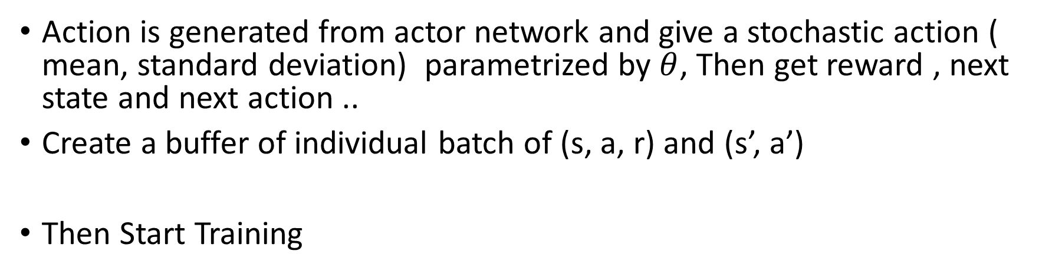
Action Generation and Buffer Formation
Action is generated from actor network and give a stochastic action ( mean, standard deviation) parametrized by $θ$, Then get reward , next state and next action ..
Create a buffer of individual batch of (s, a, r) and (s’, a’)
Then Start Training

Slide 23
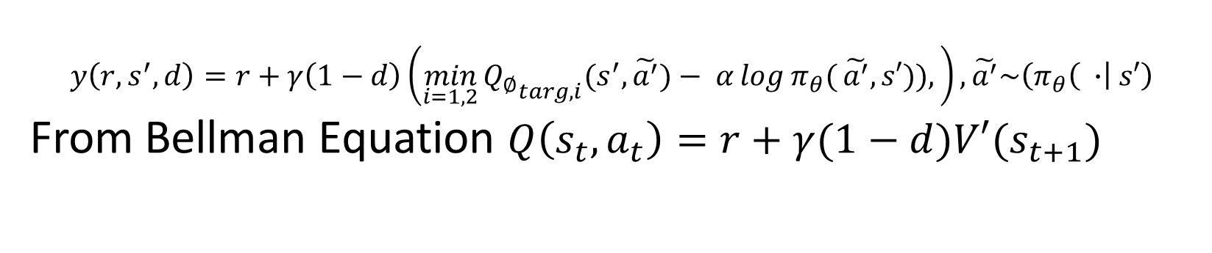
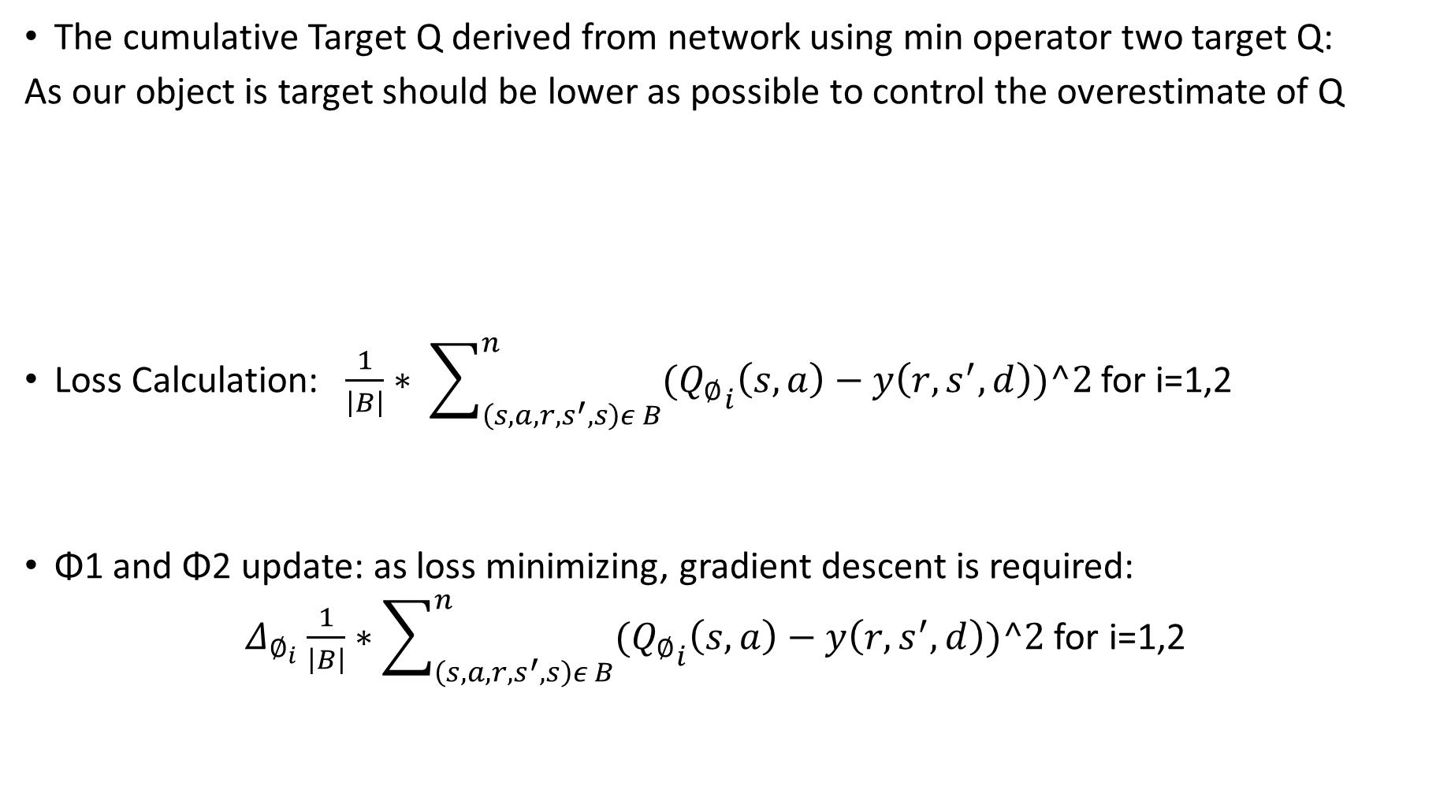
Critic Update
The cumulative Target Q derived from network using min operator two target Q:
As our object is target should be lower as possible to control the overestimate of Q
Loss Calculation: $\frac{1}{\left|B\right|}∗ \sum_{\left(s,a,r,s^{′},s\right)ε B}^{n}{({Q_{∅}}_{i}\left(s,a\right)−y\left(r, s^{′}, d\right))^2}$ for i=1,2
Φ1 and Φ2 update: as loss minimizing, gradient descent is required:
$Δ_{∅_{i}}$ $\frac{1}{\left|B\right|}∗\sum_{\left(s,a,r,s^{′},s\right)ε B}^{n}{({Q_{∅}}_{i}\left(s,a\right)−y\left(r, s^{′}, d\right))^2}$ for i=1,2
$$y\left(r,s^{′},d\right)=r+γ\left(1−d\right)\left(\min_{i=1,2}{{Q_{∅}}_{targ,i}(s^{′},\tilde{a^{′}}})− α\log{π_{θ}(}\tilde{a^{′}},s′)),\right),\tilde{a^{′}}\sim \left(π_{θ}\left( ∙\right| s′\right)$$
From Bellman Equation $Q\left(s_{t},a_{t}\right)=r+γ(1−d)V′(s_{t+1})$

Slide 24
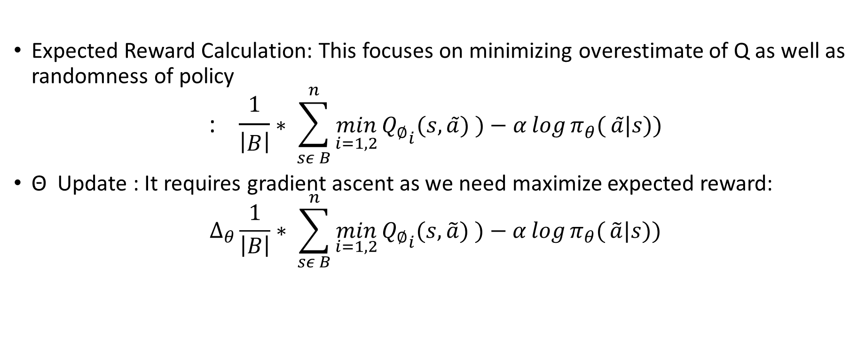
Actor Update
Expected Reward Calculation: This focuses on minimizing overestimate of Q as well as randomness of policy
$$\text{: }\frac{1}{\left|B\right|}∗ \sum_{sε B}^{n}{\min_{i=1,2}{{Q_{∅}}_{i}(s,\tilde{a}) })−α\log{π_{θ}(}\tilde{a}|s))}$$
Θ Update : It requires gradient ascent as we need maximize expected reward:
$$Δ_{θ}\frac{1}{\left|B\right|}∗ \sum_{sε B}^{n}{\min_{i=1,2}{{Q_{∅}}_{i}(s,\tilde{a}) })−α\log{π_{θ}(}\tilde{a}|s))}$$

Slide 25
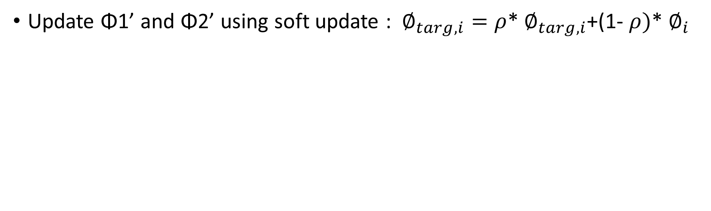
Critic Target Update
Update Φ1’ and Φ2’ using soft update : $∅_{targ,i}=ρ$* $∅_{targ,i}$+(1- $ρ)$* $∅_{i}$

Slide 26
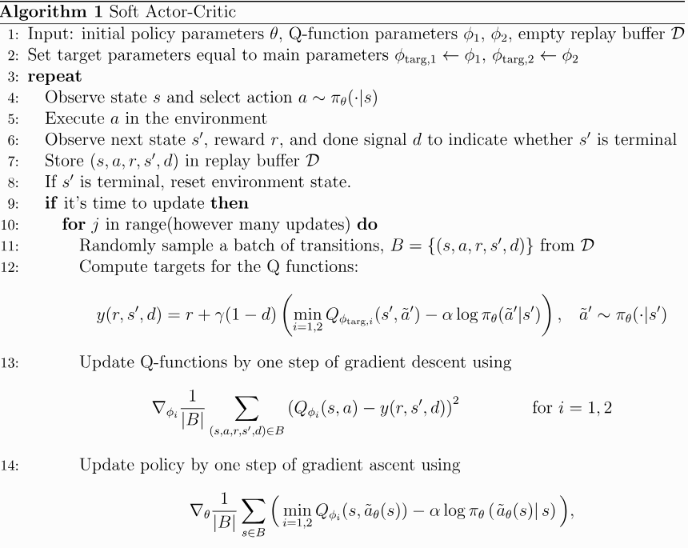
Pseudo Code SAC [7]

Slide 27
Soft Actor Critic Example with Code
Sample Code
https://github.com/openai/spinningup/blob/master/spinup/algos/pytorch/sac/sac.py
Implementation Code
https://github.com/zhihanyang2022/pytorch-sac

Slide 28
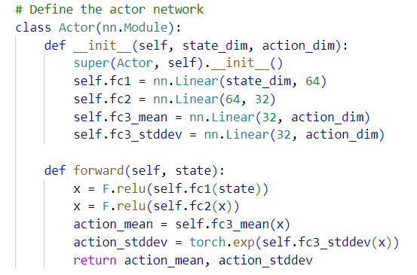
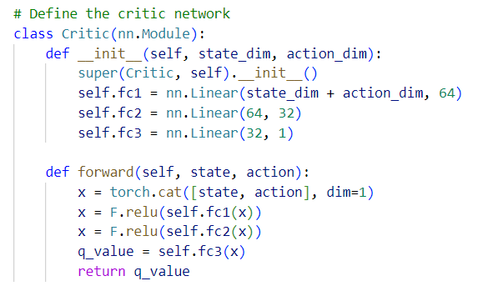
SAC Sample Code:

Slide 29
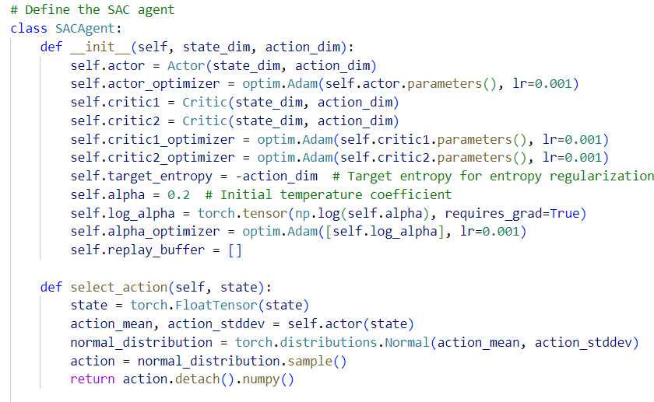
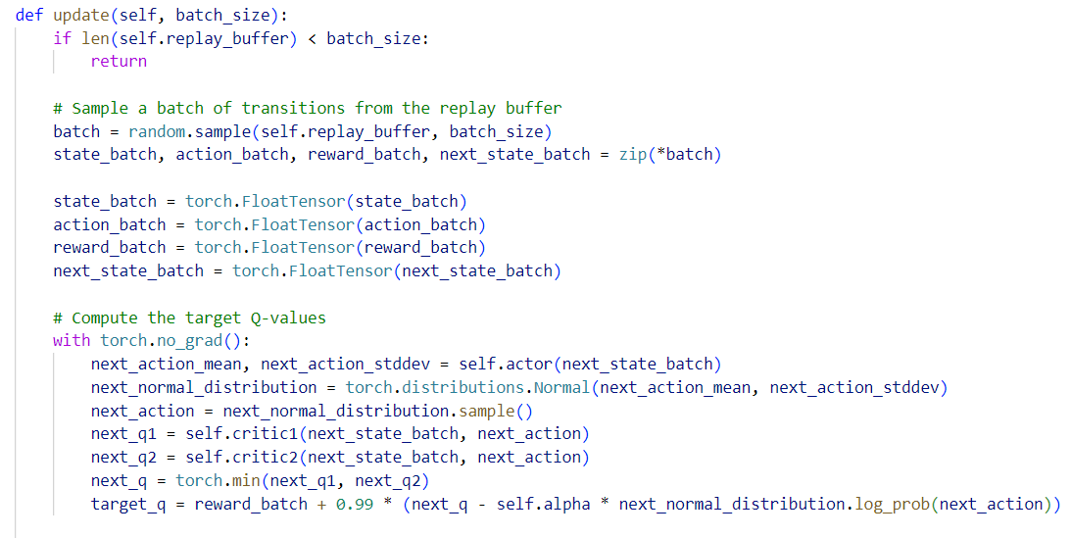

Slide 30
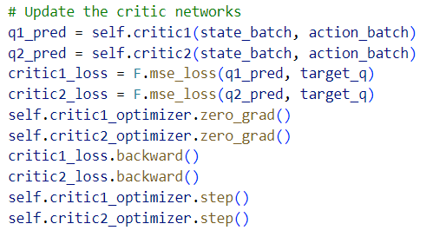
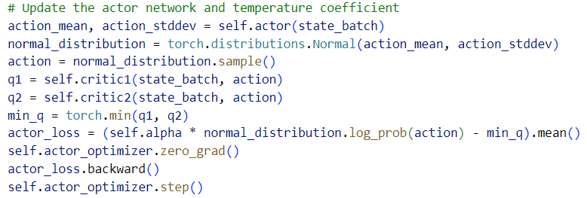

Slide 31
Reference
A3C-GS: Adaptive moment gradient sharing with locks for asynchronous Actor–Critic agents. (2021, March 1). IEEE Journals & Magazine | IEEE Xplore. https://ieeexplore.ieee.org/document/9063667
https://www.davidsilver.uk/wp-content/uploads/2020/03/MDP.pdf
De Harder, H. (2023, July 18). Techniques to improve the performance of a DQN agent. Medium. https://towardsdatascience.com/techniques-to-improve-the-performance-of-a-dqn-agent-29da8a7a0a7e
Makone, A. (2022, January 5). Reinforcement Learning 8: Pick and place robot in an E-Commerce store warehouse i.e. Q-Learning in action. Medium. https://ashutoshmakone.medium.com/reinforcement-learning-8-pick-and-place-robot-in-an-e-commerce-store-warehouse-i-e-78d7af7e60c8
Multi-Agent Reinforcement Learning using the Deep Distributed Distributional Deterministic Policy Gradients Algorithm. (2020, December 20). IEEE Conference Publication | IEEE Xplore. https://ieeexplore.ieee.org/document/9311945
BartoSutton.pdf (cmu.edu)
Soft Actor-Critic — Spinning Up documentation. (n.d.). https://spinningup.openai.com/en/latest/algorithms/sac.html
Weng, L. (2018a, February 19). A (Long) Peek into Reinforcement Learning. Lil’Log. https://lilianweng.github.io/posts/2018-02-19-rl-overview/?fbclid=IwAR161iWjfQMpTn0Z4y8MdXb3rYhPum89XD2wAS05HP49aRQeYNyjIRf9Nyk#key-concepts
L. Ale, N. Zhang, X. Fang, X. Chen, S. Wu and L. Li, "Delay-Aware and Energy-Efficient Computation Offloading in Mobile-Edge Computing Using Deep Reinforcement Learning," in IEEE Transactions on Cognitive Communications and Networking, vol. 7, no. 3, pp. 881-892, Sept. 2021, doi: 10.1109/TCCN.2021.3066619.

